Slide 1

Application:Handy Helper Type: Application Architecture View: Logical View Style: Layered Architecture Pattern
Users
Deliver Channels
Core Business Processes
Data And Information
Technology Enablers
Build profile
Web Sockets
User Account
Customers
User Data
Searching
Email
Web App
Listing
Listing Data
Payment API
Messaging
Booking Data
Booking
Ads API
Helpers
Reviewing

Slide 2
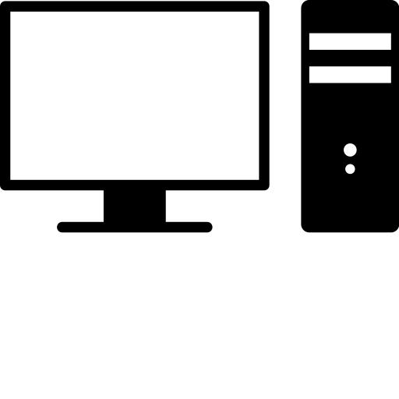

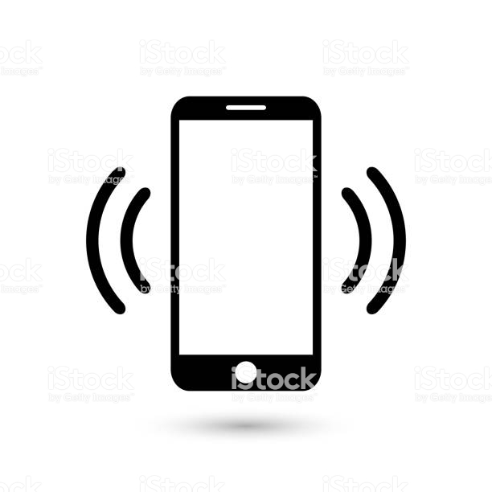
Handy Helper Web Application Type: Application Architecture View: Process View Style: Client-Server Pattern
Web Server
Instances
Database
Instances
DB Instance
Load Balancer
(AWS)
DB Instance
Admin

Slide 3
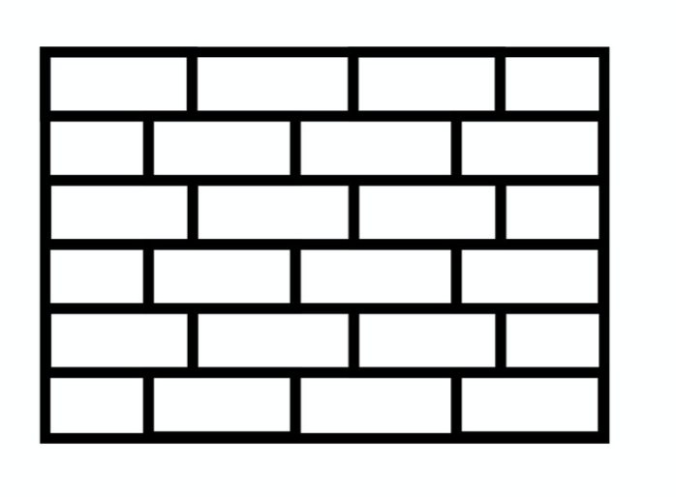



Handy Helper Web Application Type: Application Architecture View: Physical View
External Layer
Web Application Layer
Firewall
Ngnix 1.15
Internal Layer
SonicWall TZ300 Firewall
Firewall
Ngnix 1.15
Web Server
Ngnix 1.15
DB Instance (Postgres)
Ads Manager
Customer Manager
Load Balancer
(AWS)
Web Server
Ngnix 1.15
Netgear N600 Series Router
HP Z8 G4
Workstation
Cisco ISR 4331 Router
Web Server
Ngnix 1.15
DB Instance (Postgres)
HP Printer
PC
Web Server
Ngnix 1.15
Customers & Helper Users

